Slide 1
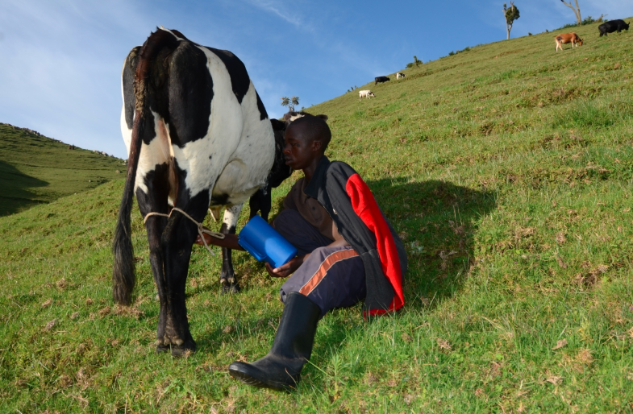
ACTION FAMILY TECH LTD.
FarmCare
A smart digital platform for precision dairy farming — combining AI, IoT sensors, cloud computing and mobile technology to improve productivity, profitability and sustainability for every dairy farmer in Rwanda.
Shingiro Finverra Pitchfest · 2026

Slide 2




01 · THE REALITY
Behind every glass of milk is a farmer fighting the odds.
Rwanda’s dairy sector is the backbone of rural livelihoods — but disease, poor breeding outcomes and lost milk quietly drain farmer income every day.
1.45–1.73M
60–67%
60%
33–50%
cattle nationwide across Rwanda’s dairy belt
of dairy cows suffer clinical or subclinical mastitis from poor hygiene
of milk rejected at collection centres in parts of the North & West
artificial insemination success — over half of cows miss pregnancy
Source: MINAGRI Annual Report 2024/25; RAB / MINAGRI
2 / 12

Slide 3



02 · THE PROBLEM
Five gaps keep Rwandan dairy farms behind.
Poor Heat Detection
Farmers struggle to accurately detect estrus, missing breeding windows and lowering AI success rates.
Milk Rejection & Poor Quality
Mastitis, bacterial contamination and water adulteration push rejection rates up across the value chain.
Disease & Environmental Burden
Diseases are often caught only after visible symptoms; poor manure handling adds emissions and cost.
No Records or Traceability
Over 95% of farmers keep no digital records of breeding, health, treatment or production — outbreaks can’t be traced.
Unmanaged Feeding & Water
Most farmers rely on seasonal grass and crop residues with no conservation such as silage or hay making.
3 / 12

Slide 4

03 · THE SOLUTION
One platform. Three connected devices.
FarmCare pairs wearable and barn sensors with AI analytics and a mobile dashboard — turning everyday farm activity into real-time decisions.
Milking Station
Barn Monitor
Health Collar
Digital milk monitoring & traceability — RFID cow ID plus mobile & USSD access replace paper records.
Smart feed, water & environment tracking via tank, pipeline and weight sensors with machine learning.
Wearable sensors for heat detection, reproductive and health monitoring, with instant SMS alerts.
Real-time data. Real farmers. Real results.
4 / 12

Slide 5
04 · HOW IT WORKS
What each device tracks — sensor by sensor.
MILKING STATION
BARN MONITOR
HEALTH COLLAR
Digital Milk Monitoring & Traceability
Smart Feed & Water Management
Smart Heat Detection & Reproductive Management
Replaces paper farm records with a digital system accessible by mobile phone and USSD.
Tracks feed consumption, water intake and environmental conditions using ML-driven analysis.
AI reads activity, movement, temperature & reproductive behaviour — sends SMS alerts, tracks insemination schedules and detects heat (estrus) with high accuracy.
Smart Milk Quality
Health & Environmental Monitoring
Flags contamination and adulteration before milk reaches the collection centre.
Continuously watches housing conditions and early animal-health indicators.
SENSORS & THEIR ROLE
SENSORS & THEIR ROLE
Wearable Motion & Temp Sensor — continuous activity and body-temperature tracking for accurate, early heat detection.
SENSORS & THEIR ROLE
RFID Tag — identifies each cow automatically at every milking.
MQ135 — monitors barn temperature & humidity.
TDS Sensor — reads electrical conductivity from dissolved sodium, potassium, calcium & magnesium to catch adulteration.
MQ5 — detects gas build-up in the barn (mukiraro).
IR Temp Sensor — reads body temperature without contact.
5 / 12

Slide 6
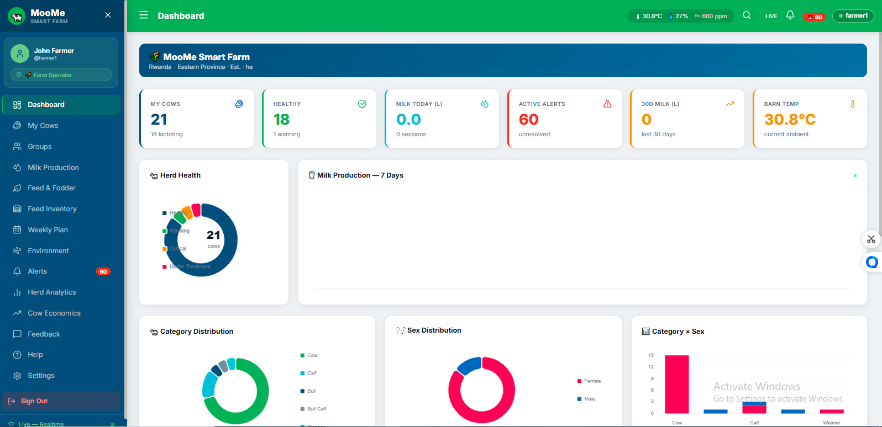

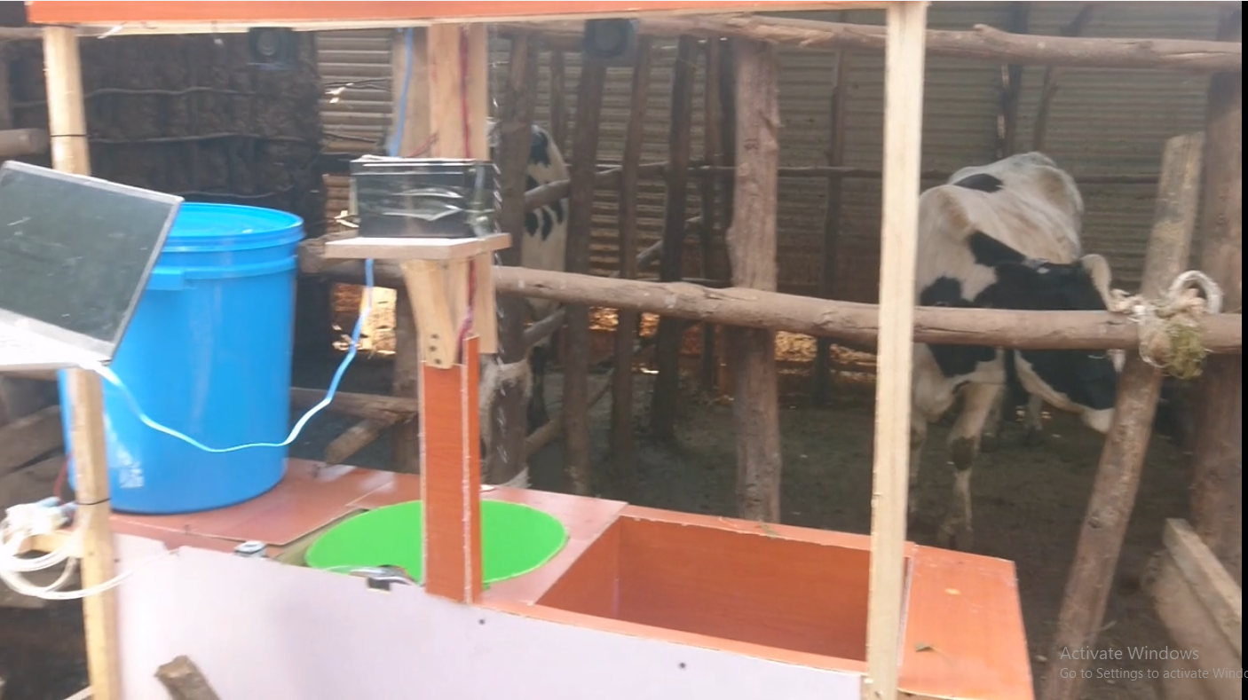
05 · PRODUCT TRACTION
Proof it works — not just a pitch.
Full web dashboard live
Registration, live milking, barn monitor, cow health & tracking, historical analytics.
All 3 hardware devices integrated
Wired, coded, and confirmed flowing live into the dashboard.
End-to-end prototype complete
Live MooMe Smart Farm dashboard
Sensor readings live and verified across all three devices.
6 / 12

Slide 7



06 · MARKET OPPORTUNITY
A market that starts with the smallholder farmer.
PRIMARY
SECONDARY
THIRD
Smallholder Farmers
Cooperatives & Processors
Institutions & NGOs
Intensive & semi-intensive zero-grazing households (1–10 cows) across Nyagatare, Gatsibo, Gicumbi, Burera and Musanze.
Dairy cooperatives and milk collection centres absorbing rejection costs, plus processors and exporters needing traceable supply.
Government bodies (MINAGRI, RAB) and NGOs such as FAO supporting sector-wide dairy programmes.
7 / 12

Slide 8



07 · BUSINESS MODEL
Three revenue streams, one growing platform.
01
02
03
Hardware Kit Sale
Dashboard Subscription
Institutional Contracts
One-time purchase of the milking station, barn monitor and/or health collar, priced around low-cost ESP32 / NodeMCU components.
A low monthly fee per farm or cow for cooperatives and commercial farms — analytics, multi-farm view, alerts.
Bundled pilot deployments with cooperatives, NGOs or government dairy programmes.
8 / 12

Slide 9
08 · COMPETITIVE LANDSCAPE
Others track one piece. FarmCare connects them all.
Agrotag
Difarm
FarmCare
WHAT THEY OFFER
WHAT THEY OFFER
WHAT THEY OFFER
Record-keeping & traceability tagging only.
Single-purpose monitoring tools.
Breeding, health, feed, milk quality & traceability in one connected platform.
GAP FARMCARE CLOSES
GAP FARMCARE CLOSES
WHY IT WINS
No reproduction or feed integration.
No link between farm data and collection-centre quality.
Directly linked to collection-centre outcomes and farmer income.
9 / 12

Slide 10


09 · FUNDING STATUS
Self-funded to prototype. Seed funding to reach the field.
FarmCare has been built entirely with founder funds — no external investment to date. We are applying to the Shingiro Finverra Pitchfest for seed funding to move from working prototype to a real on-farm pilot.
Hardware Production
Field Testing
Cooperative Partnership
A small production run of ESP32 / NodeMCU boards, sensors and enclosures.
On-farm testing with a real herd to validate performance under daily conditions.
Our first signed cooperative partnership agreement to launch the pilot.
10 / 12

Slide 11
10 · THE TEAM
Built by two founders, one mission.
IE
BJ
IZERE Egide
BIKORIMANA Jean Claude
Environmmentol expert
IT SPECIALIST
0787 979 145
0786 144 292
11 / 12

Slide 12
Thank You
Questions & Answers
FarmCare · Action Family Tech Ltd.
IZERE Egide, CEO · 0787 979 145 BIKORIMANA Jean Claude, Founder · 0786 144 292

